Slide 1
Predicting Stock Market Trends Using Machine Learning and Deep Learning Algorithms MOJTABA NABIPOUR POOYAN NAYYERI HAMED JABANI SHAHAB S. AMIR MOSAVI
SASHANK MVV
1911028

Slide 2
SECTIONS
PART 1-INTRODUCTION
PART 2-RESEARCH DATA
PART 3-PREDICTION MODELS
PART 4-EXPERIMENTAL RESULTS
PART 5-CONCLUSION

Slide 3
INTRODUCTION
The task of stock prediction has always been a challenging problem for statistics experts and finance.
There are two ways for stock market prediction.
Fundamental analysis
Technical analysis
The data gained from stock values are efficiently preprocessed and suitable algorithms are employed, the trend of stock values and index can be predicted
In this research, performance of nine machine learning models (Decision Tree, Random Forest, Adaboost , XGBoost , SVC, Naïve Bayes, KNN, Logistic Regression and ANN) and two deep learning methods (RNN and LSTM) are analyzed to predict stock market movement
Ten technical indicators are utilized as inputs to the models

Slide 4
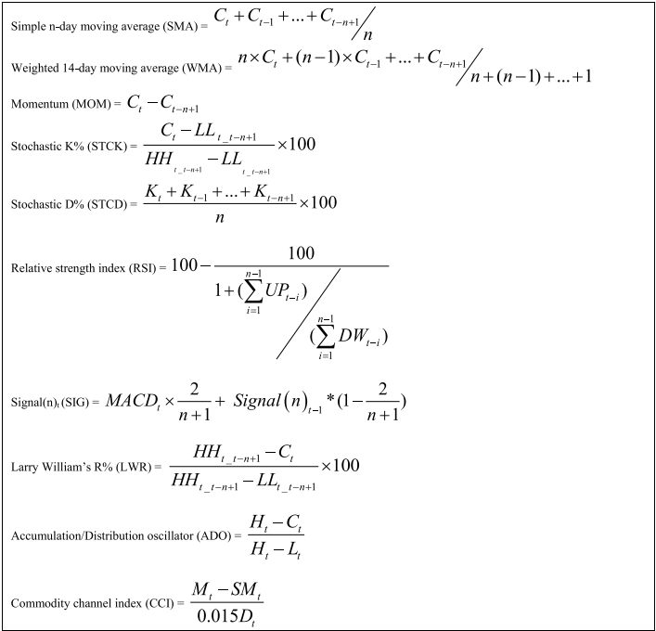
TECHNICAL INDICATORS

Slide 5
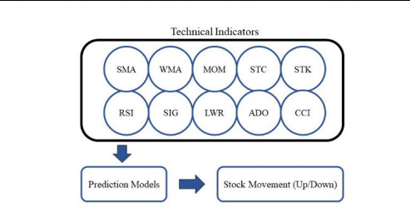
RESEARCH DATA
CONTINOUS DATA
In this method, input values to prediction models are computed using various formulas for each technical indicator. The indicators are normalized in the range of (0, +1) before using to prevent overwhelming smaller values by larger ones. The process of stock trend prediction with continuous data is shown below

Slide 6
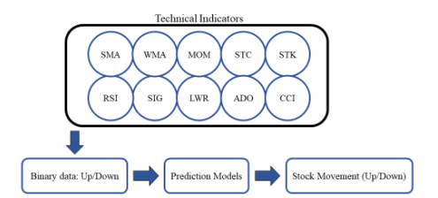
BINARY DATA
In this approach, a new step is added to convert continuous values of indicators to binary data based on each indicator’s nature and property

Slide 7
SMA and WMA: if current value is below the moving average then the trend is −1, otherwise it is +1.
MOM: if the value of MOM is positive then the trend is +1, otherwise it is −1.
STCK, STCD, LWR, MACD and ADO: if the current value (time t) is more than the previous price (time t-1) then the trend is +1, otherwise it is −1.
If the RSI value surpasses 70 then the trend is −1, and if the value goes below 30 then the trend is +1. For values between 30 and 70, if the current value (time t) is larger than the prior value (time t-1) then the trend is +1, otherwise it is −1.
CCI: if values surpass 200 then the trend is −1 and if values go below −200 then the trend is +1. For values between −200 and 200, if the current value (time t) is larger than the prior value (time t-1) then the trend is +1, otherwise it is −1.

Slide 8
PREDICTION MODELS
DECISION TREE:Decision Tree is a common supervised learning approach employed for both regression and classification problems
RANDOM FOREST :Great number of decision trees make a random forest model. The model basically averages the forecast result of trees, which is named a forest.
ADABOOST :The process of converting some weak learners to a powerful one is named Boosting method. AdaBoost is a specific type of Boosting that is an ensemble model to progress the predictions of every learning technique.
XGBoost is a recent ensemble model based on decision trees. This employs the rules of Boosting for weak learners similarly. XGBoost was presented for better performance and speed compared to other tree-based models
ANNs are a prominent subset of machine learning algorithms that are usually single or multi-layer nets which fully connected together.

Slide 9
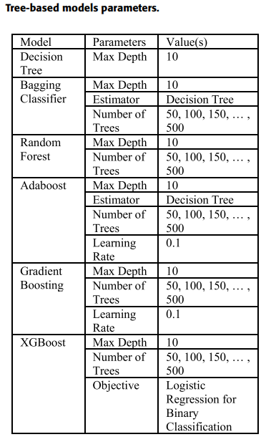
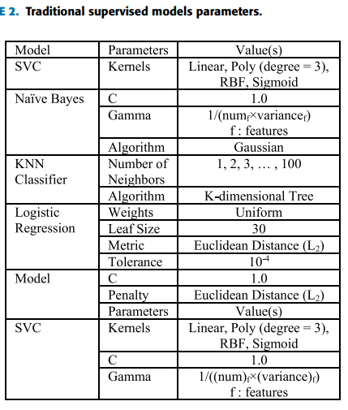
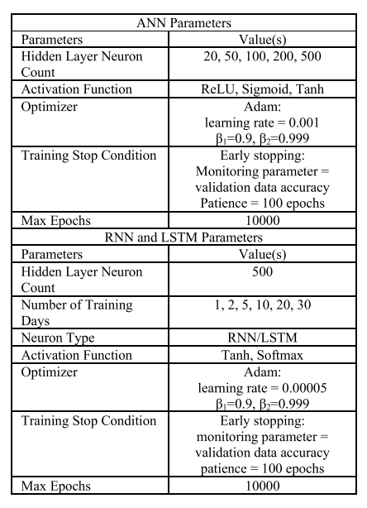
MODEL PARAMETERS

Slide 10
EXPERIMENTAL RESULTS
For training machine learning models, we implement the following steps: normalizing features (just for continuous data), randomly splitting the main dataset into train data and test data (30% of dataset was assigned to the test part), fitting the models and evaluating them by validation data (and ‘‘early stopping’’) to prevent overfitting, and using metrics for final evaluation with test data
F1-Score, Accuracy and Receiver Operating Characteristics Area Under the Curve (ROC-AUC) metrics are employed to evaluate the performance
All coding process in this study is implemented by python3 with Scikit Learn and Keras library

Slide 11
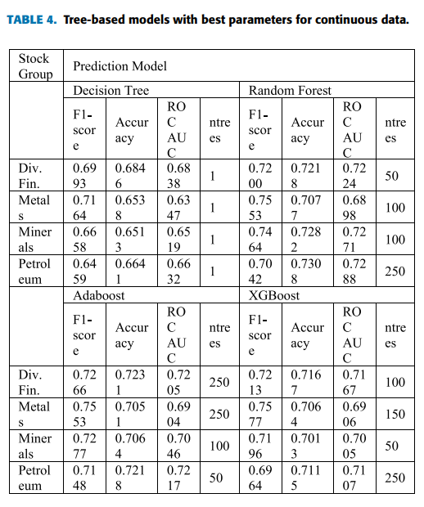
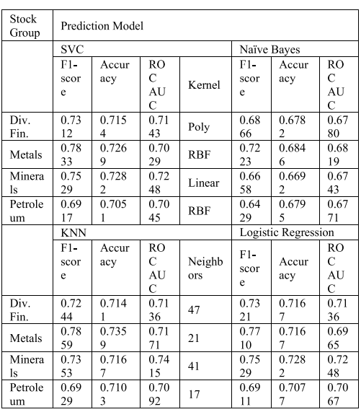
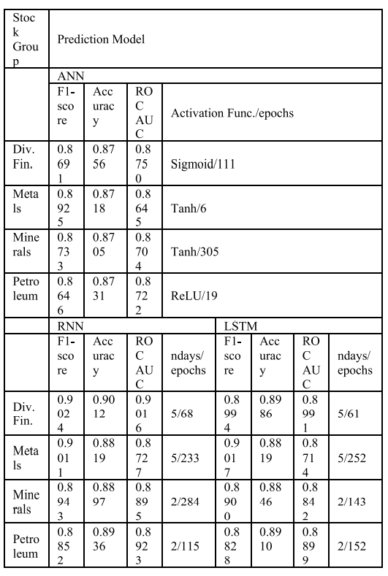

Slide 12
CONCLUSION
The purpose of this study was the prediction task of stock market movement by machine learning and deep learning algorithms
Nine machine learning models (Decision Tree, Random Forest, Adaboost, XGBoost, SVC, Naïve Bayes, KNN, Logistic Regression and ANN) and two deep learning methods (RNN and LSTM) were employed as predictors. Two approaches for input values to models, continuous data and binary data, and three classification metrics for evaluations were employed
There was significant improvement in accuracy when binary data was used as compared to continuous data
Deep learning algorithms (RNN and LSTM) were the superior models in both approaches

Slide 13
STRATEGY TO IMPLEMENTATION.
Using Scikit Learn and Keras library.
The dataset to be used is available in Kaggle.

Slide 14
References
Research paper :https://ieeexplore.ieee.org/document/9165760?denied=
Technical indicators :https://www.investopedia.com/
Deep learning models :http://www.analyticsvidhya.com/

